Slide 1
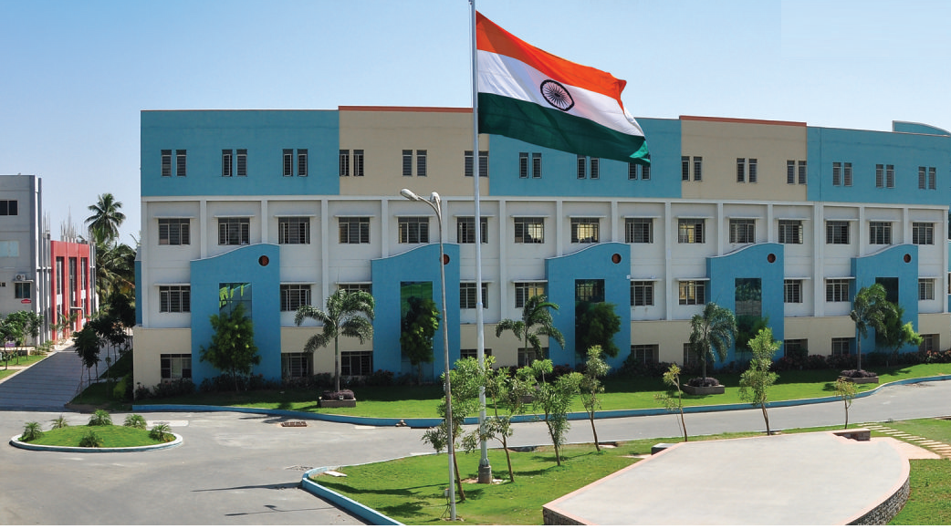
SRI ESHWAR COLLEGE OF ENGINEERING academic year: 2016-17 department: section:
FINAL YEAR PROJECT REVIEW – 1
Date of review:

Slide 2
Title of the project
Batch Members
1
2
3
Guide Name
Dr.C.Venkatesh
Asso.Prof/ECE Dept.

Slide 3
Presentation Outline
Name and Address of Company and External Guide details (If Applicable)
Abstract
Literature Survey
Objective
Expected Outcome
Execution Plan

Slide 4
Abstract of the project

Slide 5
Literature Survey
Chenggao Han, Hashimoto, T & Suehiro, N (2010), “Constellation-rotated vector OFDM and its performance analysis over rayleigh fading channels”, IEEE Trans. Commun., vol.58, pp. 828-838. (paper title format)
(Minimum three lines about above mentioned paper)
Per slide 2 papers- Maximum of 2 slides

Slide 6
Literature Survey (Cont’d..)
Chenggao Han, Hashimoto, T & Suehiro, N (2010), “Constellation-rotated vector OFDM and its performance analysis over rayleigh fading channels”, IEEE Trans. Commun., vol.58, pp. 828-838. (paper title format)
(Minimum three lines about above mentioned paper)
Per slide 2 papers- Maximum of 2 slides

Slide 7
Objectives

Slide 8
Introduction

Slide 9
Introduction (Cont’d..)

Slide 10
Key Skills

Slide 11
Block Diagram (or) Circuit Diagram

Slide 12
Explanation

Slide 13
Feasibility Analysis

Slide 14
Expected Outcome (or) Results and Discussion

Slide 15
Competitions Targeted
(Example)
Mitsubishi
NI
TI
ICTACT
Project Competitions from other Colleges

Slide 16
How this project will be converted into commercial product?

Slide 17
Journal Publications related to the Project

Slide 18
Work Schedule

Slide 19
References
Minimum 5 Recent journal paper references

Slide 20
Queries?

